Slide 1

Rami Wail, Ahmed Alaa, Mohamed Hatem
201600112 - 201600352-201600075
DG - FinFet: Project Presentation 2
Supervised by : Dr Amr Bayoumi.
Naneng 520

Slide 2
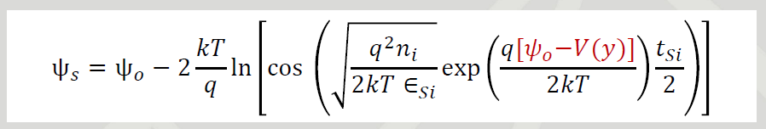
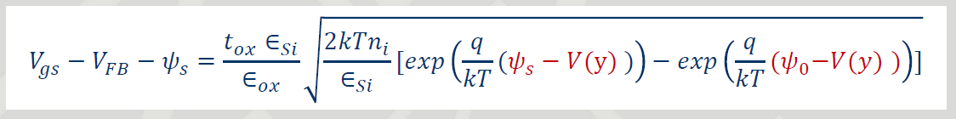

Slide 3

Damped newton raphson method

Slide 4
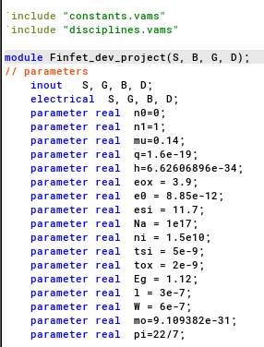
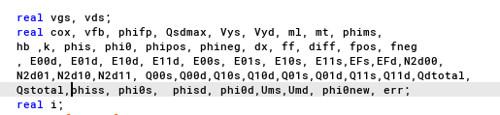
Verilog A - Parameters

Slide 5
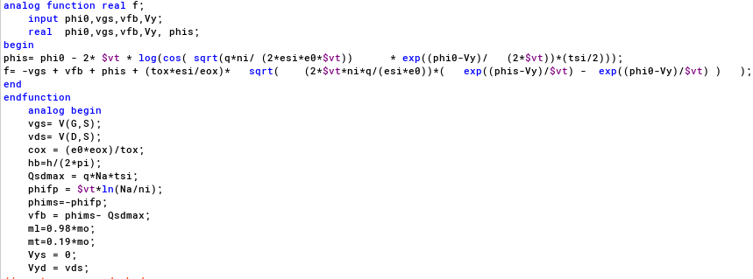
Verilog A

Slide 6
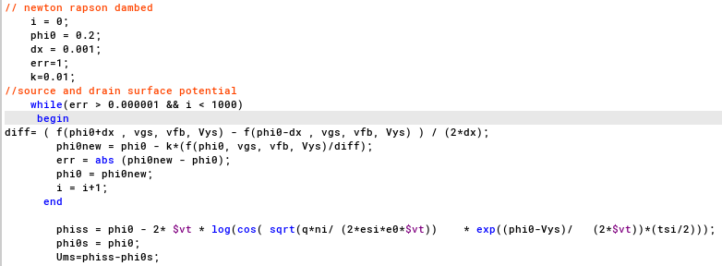
Verilog A

Slide 7
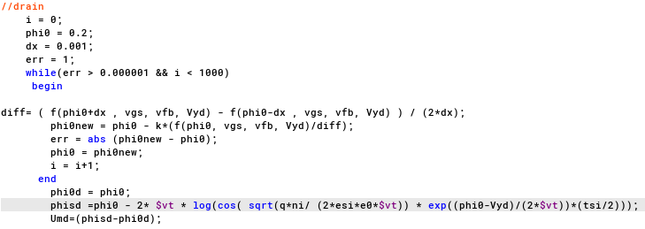
Verilog A

Slide 8
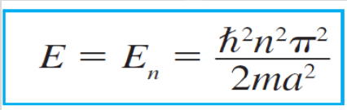
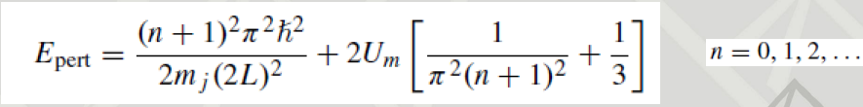
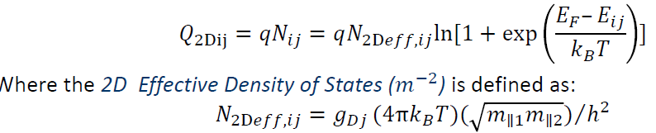
Quantum equations

Slide 9
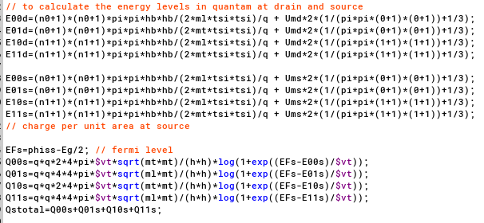
Verilog A

Slide 10
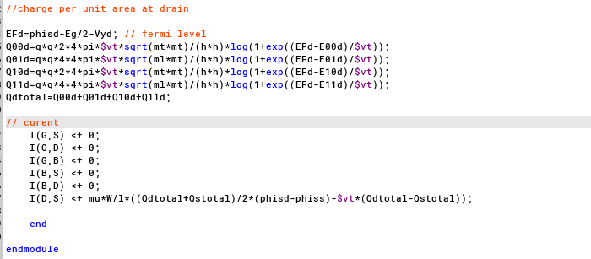
Verilog A

Slide 11
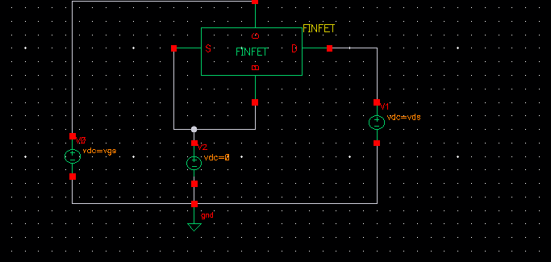
Testing circuit

Slide 12
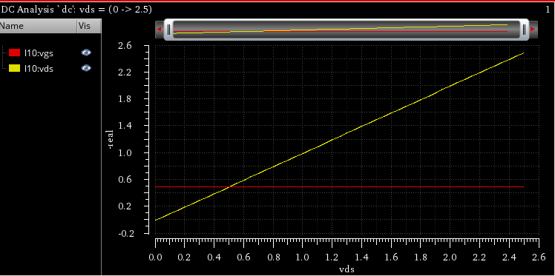
Results -voltage

Slide 13
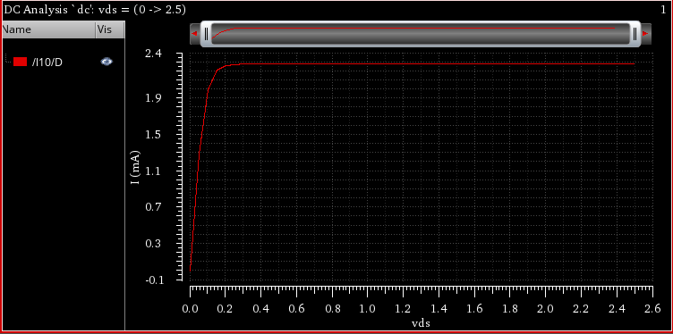
Current at drain

Slide 14
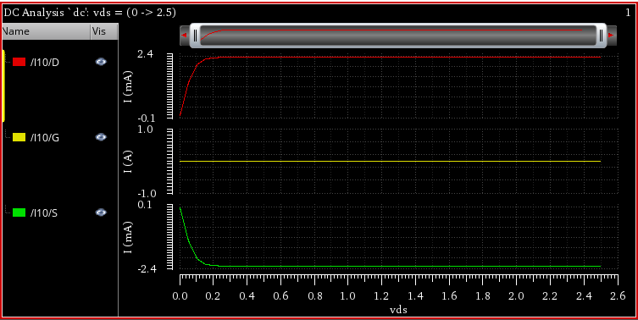
currents

Slide 15
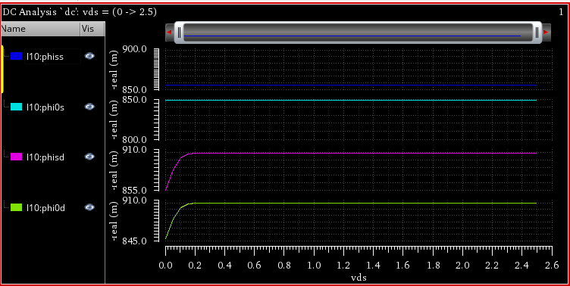
Surface potential

Slide 16
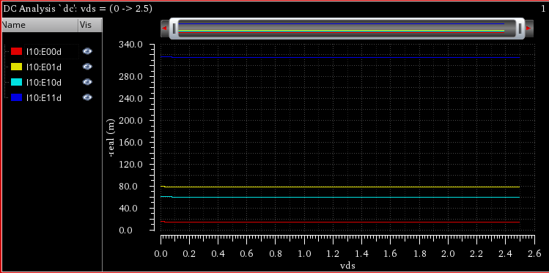
Energy levels at source

Slide 17
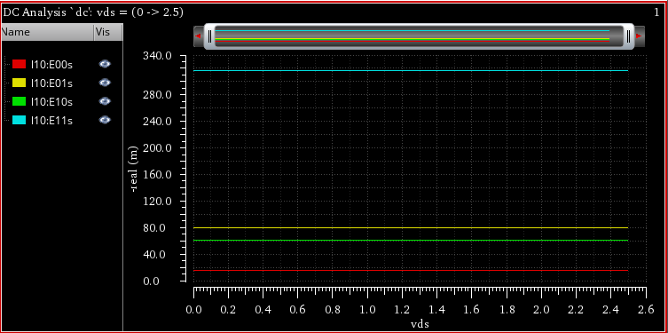
Energy levels at drain

Slide 18
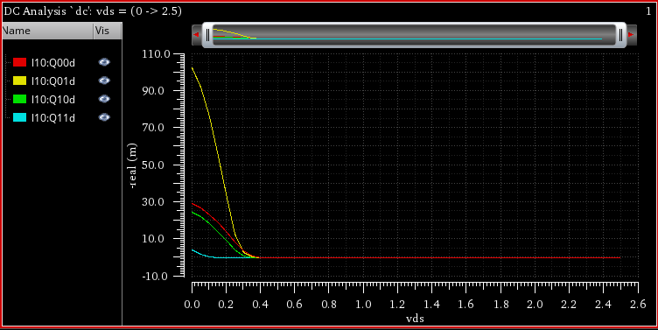
Charge per unit area

Slide 19
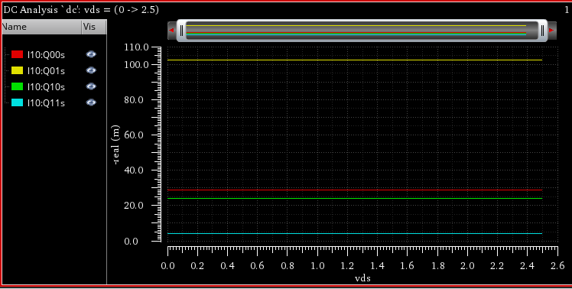
Charge per unit area

Slide 20
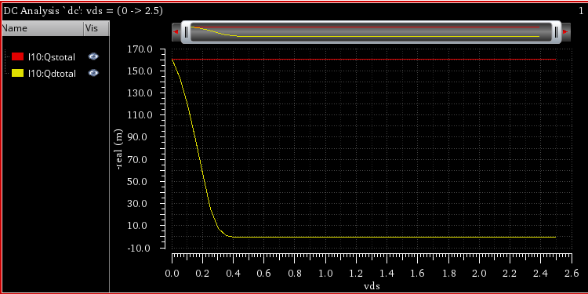

Slide 21
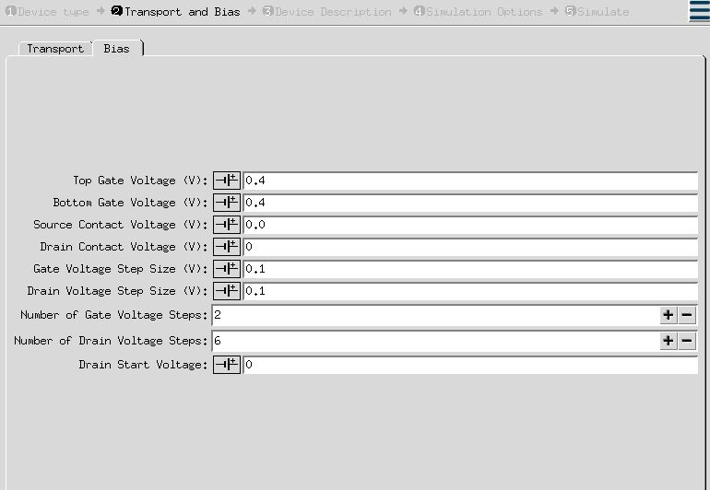
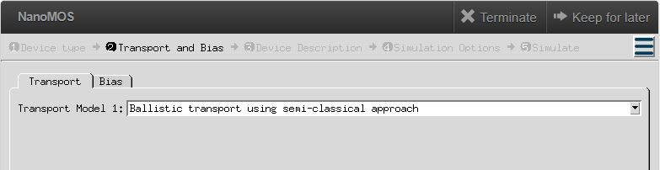
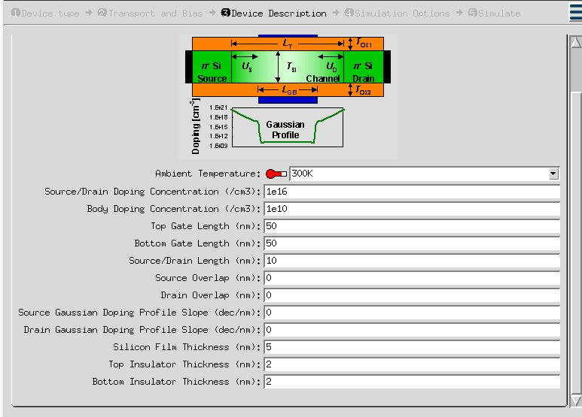
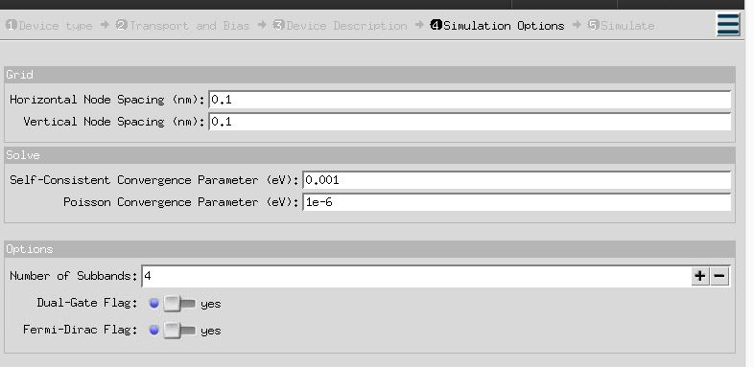
Nanohub tool

Slide 22
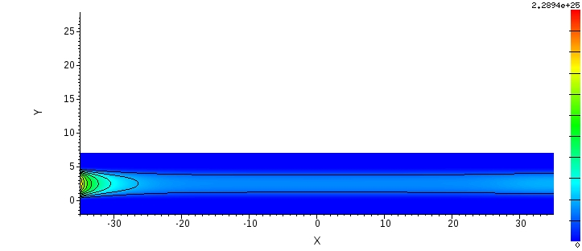
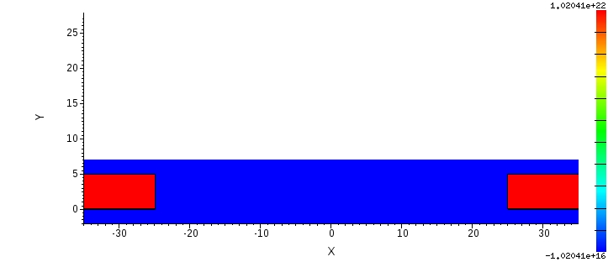
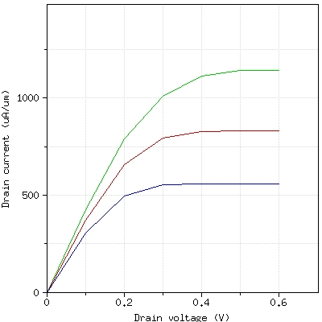
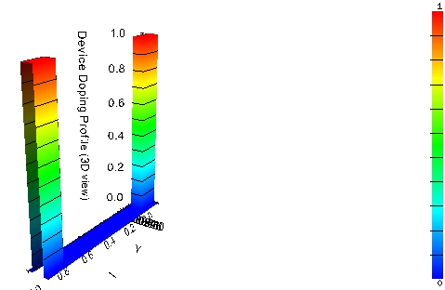
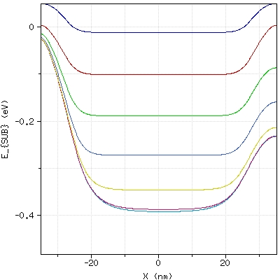
Nanohub simulation
ElectrondensityprofilePlaneview
Doping Profile
DraincurrentvsDrainvoltage
FirstSubbandenergyprofilealongthechannelatdifferentVd
DeviceDopingProfile3Dview

Slide 23
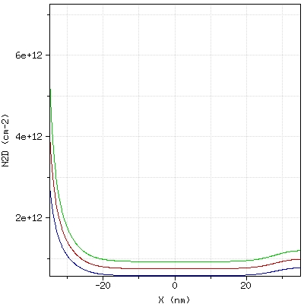
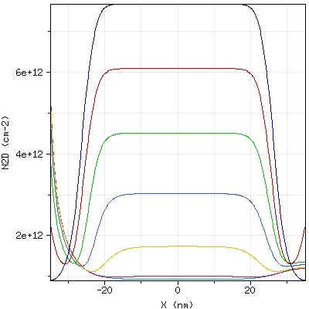
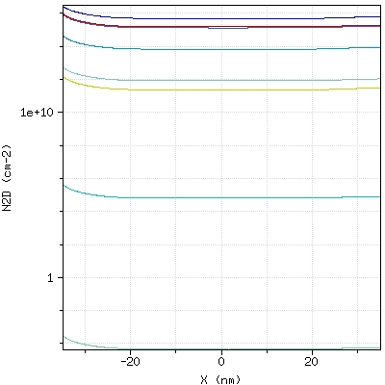
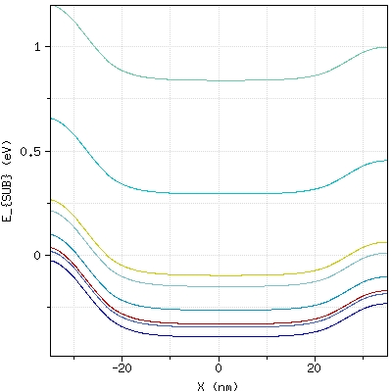
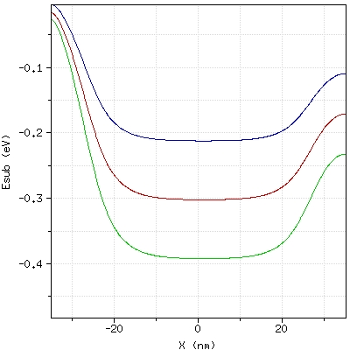
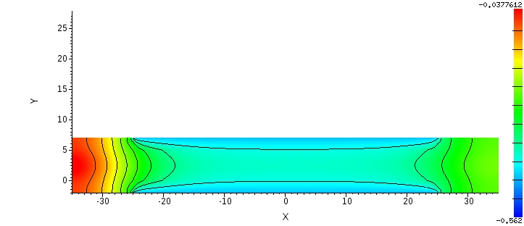
Nanohub simulation
2D electron Density Along The Channel at Different Vd
Average Electron Velocity Along the Channel
Draincurrent vs Drainvoltage
First Subbands energy along the channel
Conduction band edge potential profile Planeview
The Subbands energy profile along the channel

Slide 24
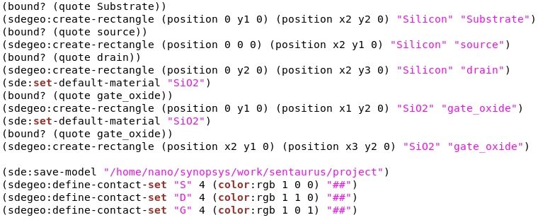
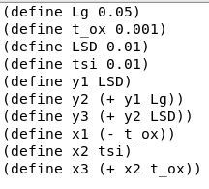
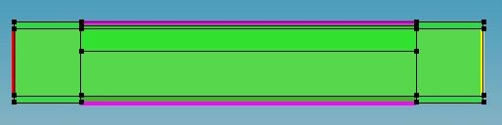
Sentaurus sde

Slide 25
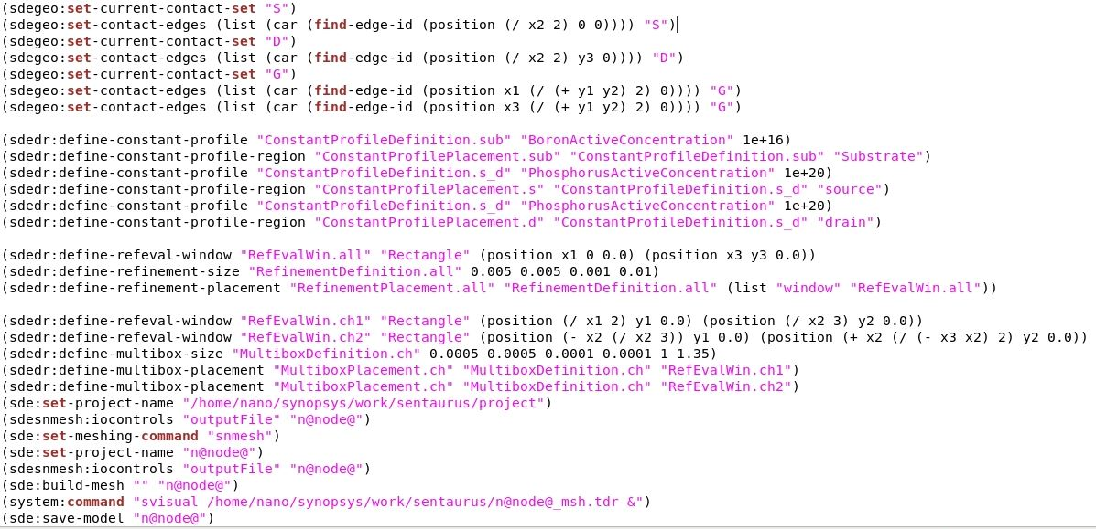
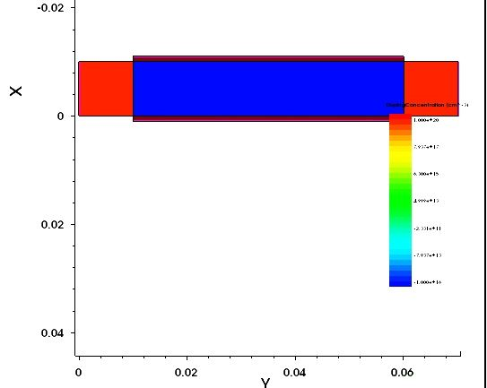
Sentaurus sde

Slide 26
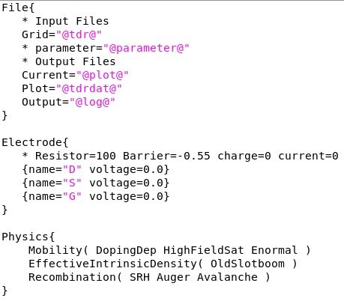
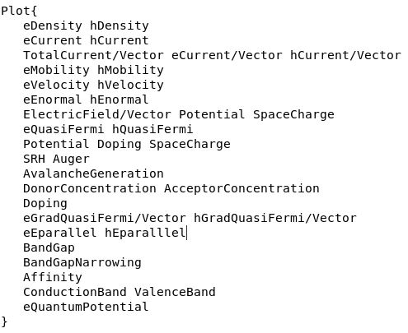
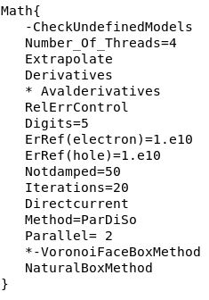
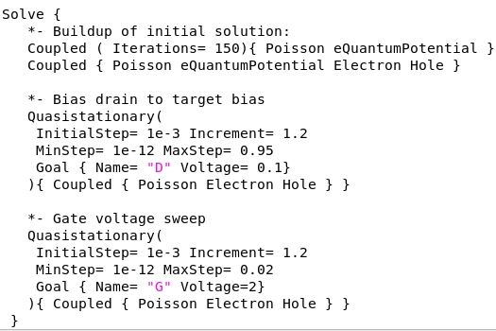
Sentaurus sdevice

Slide 27
Tasks Partitioning
Task | Rami | Ahmed | Mohamed
Verilog A | Quantum equations and calculations | Newton raphson solution | Classical equations & Parameters
Nano hub tool | Ballistic transport using semi-classical approach | Drift-Diffusion transport model | Ballistic Transport using Green’s function approach
Sentaurus sde | Geometry and profile | Parameters and contacts | Doping and meshing
Sentaurus sdevice | File, electrode, physics | Plot | Math, solve

Slide 28
Thank you

